Slide 1

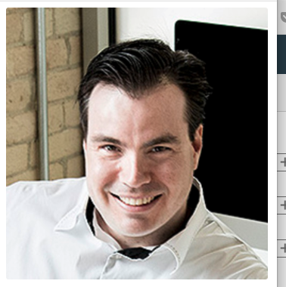

BUILDING SMART CITIES
Research Proposal Presentation
Shawn Berney
MBA Student
April 2018
Research Methods, preparation and presentation | BUSN-6951

Slide 2
Outline
Introduction
Research Question
Literature Review
Methodology
Data Presentation
Building Smart Cities
Define “smart city” + research context
Can we build a smart city?
Where to begin…
Making a plan!
Graphs and charts
Concluding remarks and summary

Slide 3
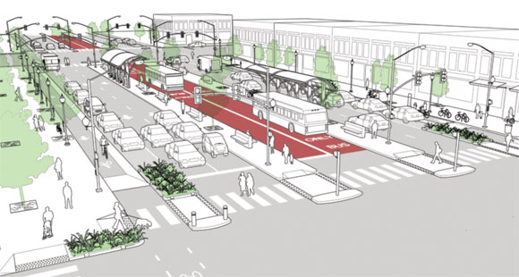
Introduction
How do we define a smart city?
What are the business problems today? What products and services are needed?
Business of IT and Management Consulting
Understanding new realities
Seeking good data with an open mind

Slide 4

Research Question
What is the current and projected industrial capacity for supporting the technology transition and organizational reconfiguration needed to implement the Sidewalk Labs smart city project in Toronto?

Slide 5
Literature Review
Collaboration
Governance
Knowledge creation
People
Better by design
Innovation and change
Standardization
Define “Smart City”
+ Categorization
Technology
Industrial capacity
Adapting to change
Structural Cycles
Economics

Slide 6
Methodology
Open source software
Patent data analysis
Firms (NAICS codes)
Ontology supported clustering
Innovation
Policies
Programs
Regulation
Examination and evaluation
Governance
Disruption of mature industries causing technological transition and organizational reconfiguration
Structural Cycles

Slide 7


Methodology
Structural Cycles
Data Transformation
Regression and Trend Analysis
Structural Equation Modelling (SEM)

Slide 8
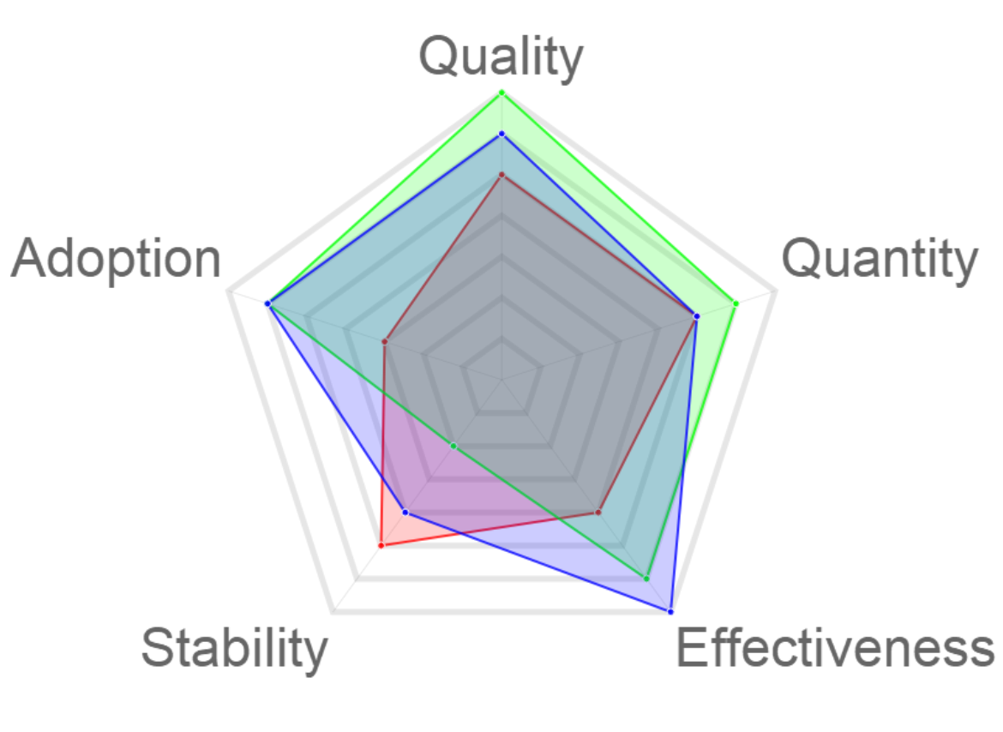
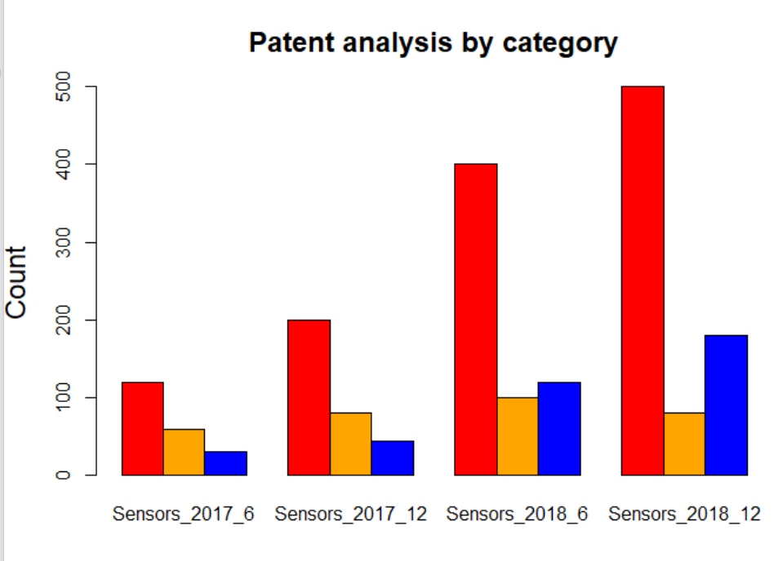
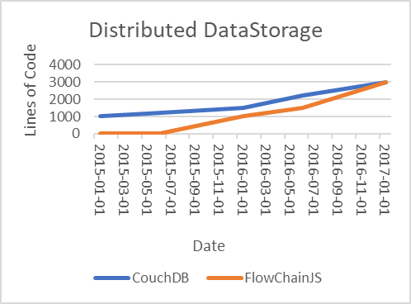
Data Presentation
Innovation
Governance
Patents
Software
Current state
Radar graph presentation
7 point Likert scale
6 Snapshots, 3 yrs
Bar chart presentation
Patent cluster over time
6 Snapshots, 3 yrs
# of lines of code
Growth over time

Slide 9

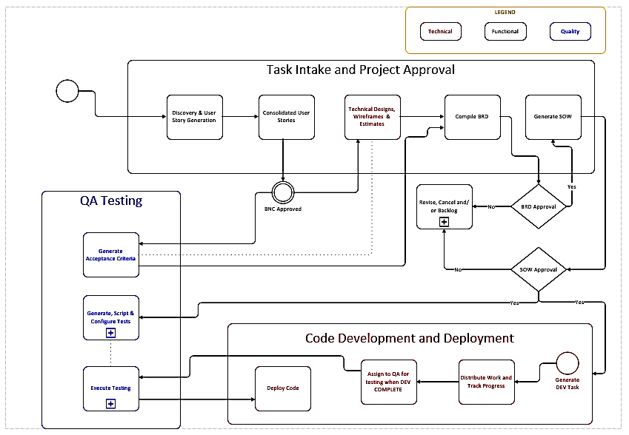

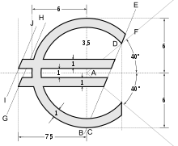
Building Smart Cities
Technology
People
Economics
Understanding our industrial capacity
Applying governance
Driving economic prosperity

Slide 10
Thank you!
Shawn Berney
MBA Student
April 2018

